Slide 1

Introduction, Purpose of Forecasting, Methods of Forecasting

Slide 2

Demand forecasting means expectations about the future course of market demand of a product. Demand forecasting is based on the statistical data about the past behavior and empirical relationship of demand determinants.

Slide 3

Based on time period
a) Short term demand forecasting
b)Long term demand forecasting
Based on level of forecast
a)Firm level
b)Industry level
c)National level
d)Global level

Slide 4
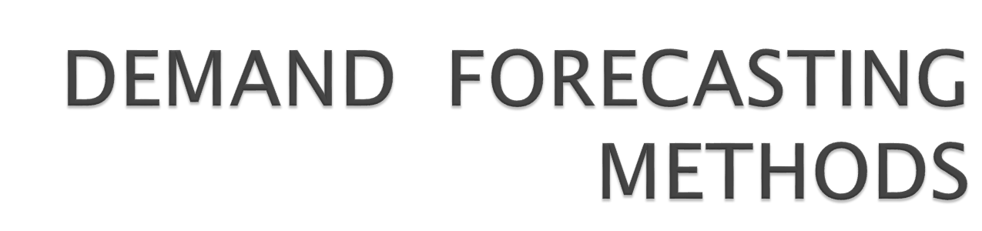

Slide 5

To assess the likely demand.
To plan the production accordingly.
To plan the INPUTS (factors of productions) Manpower (labour), Raw material, and Capital.

Slide 6
Demand Forecasting Methods
Statistical
survey
other
Trend projection
methods
Survey of buyer
intentions
Expert opinion
Sales force opinion
Barometric
Test marketing
Correlation
Delphi method
Controlled
experiments
Regression
Self judgment
method

Slide 7

DEMAND FORECASTING METHODS are classified into
Survey methods
Statistical methods
Other methods

Slide 8

Survey of buyer intentions
Census method
Sample method
Sales force opinion method
Delphi Method

Slide 9
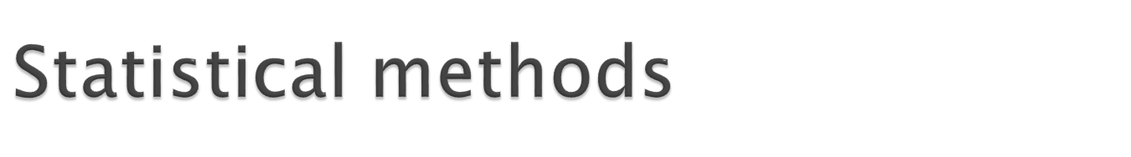
Trend projection methods
Barometric techniques
Simultaneous equation method
Regression & correlation methods

Slide 10

Expert opinion method
Test marketing
Controlled experiments
Judgmental approach

Slide 11
Survey of buyer intentions: in this method information is drawn from the buyer to estimate demand.
In this method each potential buyer is asked how much does he plan to buy, of the given product at a given point of time under particular condition.
This is the most effective method because the buyer is the ultimate decision maker, & we are collecting the information from the potential buyer.

Slide 12
Survey can be conducted by considering either whole population or by selecting a small group of potential buyers.
If survey is conducted by considering the whole population it is called CENSUS method. CENSUS method is also called as TOTAL ENUMERATION method.
If survey is conducted by considering the small group of potential buyers who can represent the whole population, it is called SAMPLE method.

Slide 13
2. Sales force opinion method: Sales people are in constant touch with the large number of buyers of a particular market.
Sales force constitute valid source of information about the likely sales of a product
Sales force is capable of assessing the likely reaction of the customers of their territories quickly, given the companies marketing strategy.

Slide 14
3.Delphi Method: A variant of the survey method is Delphi method. It is a sophisticated method to arrive at a consensus. Under this method, a panel is selected to give suggestions to solve the problems in hand. Both internal and external experts can be the members of the panel. Panel members one kept apart from each other and express their views in an anonymous manner. There is also a coordinator who acts as an intermediary among the panelists. He prepares the questionnaire and sends it to the panelist. At the end of each round, he prepares a summary report. On the basis of the summary report the panel members have to give suggestions.

Slide 15
1.Trend projection methods:
A well-established firm will have accumulated data. These data is analyzed to determine the nature of existing trend. Then, this trend is projected in to the future and the results are used as the basis for forecast.
There are five main techniques
Trend line by observation
Least square method
Time series analysis
Moving averages method
Exponential smoothing

Slide 16
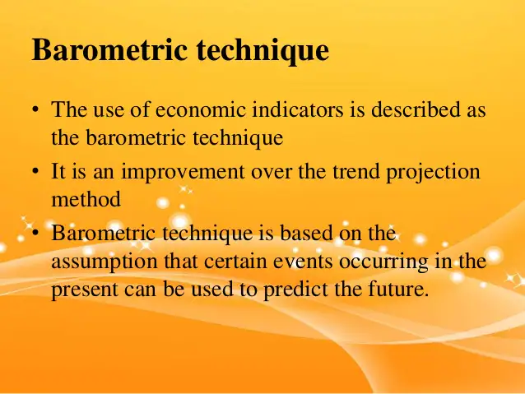

Slide 17
2.Barometric technique: under this technique one set of data is used to predict another set.
In other words to forecast demand for a product , some other relevant indicator, which is known as BAROMETER is used to forecast the future demand.
E.g.. To forecast demand for cement the relevant indicator number of new construction projects, are taken into consideration for forecasting demand.

Slide 18
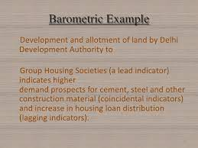

Slide 19
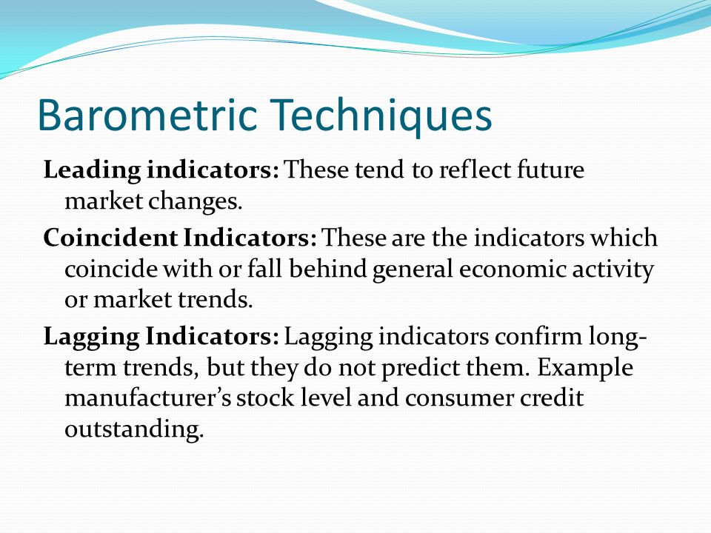

Slide 20
3.Correlation describes the degree of association between two variables such as sales and advertisement expenditure.
When two variables tend to change together then they are said to be correlated.
The extent to which they are correlated is measured by correlation coefficient.
For example if sales have gone up as a result of increase in advertisement expenditure we can say that sales and advertisement are positively correlated.

Slide 21
4.Regression analysis: A statistical measure that attempts to determine the strength of the relationship between one dependent variable (usually denoted by Y) and a series of other changing variables (known as independent variables).
The two basic types of regressions are linear regression and multiple regression. Linear regression uses one independent variable to explain and/or predict the outcome of Y, while multiple regression uses two or more independent variables to predict the outcome.

Slide 22
The general form of each type of regression is:
Linear Regression: Y = a + bX + u
Multiple Regression: Y = a + b1X1 + b2X2 + B3X3 + ... + BtXt + u
Where:
Y= the variable that we are trying to predict
X= the variable that we are using to predict Y
a= the intercept
b= the slope
u= the regression residual.

Slide 23
1.Expert opinion method: an expert is good at forecasting and analyzing the future trends for a given product or service at a given level of technology.
Apart from salesmen, consumers & distributors, outside experts may also used for forecasting. In the United States of America, the automobile companies get sales estimates directly from their dealers. Firms in advanced countries make use of outside experts for estimating future demand.

Slide 24
2.Test marketing: in test marketing the entire product and marketing program is carried for the first time in a small number of well chosen and authentic sales environment.
The primary objective of test marketing is to know whether the customer will accept the product in the present form or not

Slide 25
3.Controlled experiments: major determinants of demand are manipulated to suit to the customers with different tastes and preferences
In this method the product is introduced with different packages, different prices, in different markets to assess which combination appeals to the customer most

Slide 26
4.Judgmental approach: when none of statistical and other methods are directly related to the given product/service the management has no alternative other than using its own judgment in forecasting the demand.

Slide 27
